Slide 1
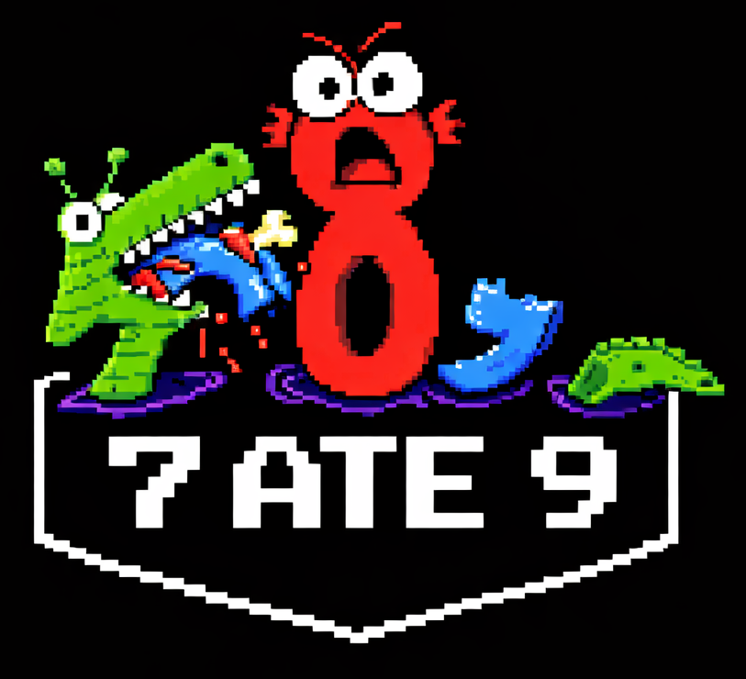
TEAM SEVEN ATE NINE
Arm Slot machine II presentation

Slide 2
Research
Slot machine design language, animations, layout
Multiple reels, Colorful layout, Multiple slot machines
Features commonly seen in slot machines
Login system, Persistent balance across devices
General good frontend coding practices
Responsive, Good animations, Consistent formatting
General good backend coding practices
Separation of concerns, Meaningful variable and function names
Codex how to properly use
AGENTS.md, SKILLS.md, MCP Configuration
How to keep users happy
Sound effects, Wins should be rewarding, Losses should be quick

Slide 3
Initial Strategy
We equipped Codex with the Playwright skill to allow for it to check what it's doing with a browser.
We also made AGENTS.md with all general requirements and guidelines for Codex
We also equipped Codex with skills to create PRs and resolve issues we make on github
We will be using GPT-5.4 with medium reasoning.
We will be focusing on giving it very well specified issues on github so that it can execute and open a PR on them.

Slide 4
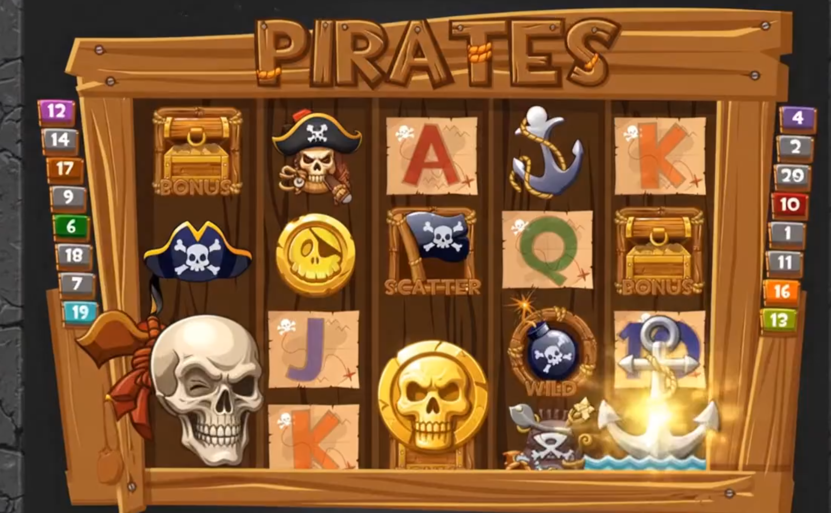
Primary Objective
A fully fledged Slot Machine website with a pirate theme
It will have a variety of features commonly seen in other slot machines + features to keep player engagement
Cache login with password encryption + guest login
Soundtrack and sound effects
Animations
Leaderboard system
Buy cosmetics with tokens won.

Slide 5
Tech Stack
We used the MERN tech stack for the following reasons
MongoDB - Lightweight database to store login information, account balances, leaderboard data
Express - Simplest serving middleware our team knew
React - Modular and easy frontend library that our team could easily understand
Node.JS - The classic backend system that allows all the other 3 technologies to easily integrate
Implementation
We created issues on github for independent features
Then we had codex read the issues to create pull requests
Imported pirate themed assets and had the codex integrate it into the website

Slide 6
Problems we faced
Codex produced UI which was not good looking
On complex tasks, codex usually ignored the general guidelines and sometimes forgot to push changes and create a PR
Utilized front-end skill mainly, still made a not great looking frontend
When given many instructions in a github issue, it only chose to follow a few
Did not give an explanation why it did not do the issue items!

Slide 7
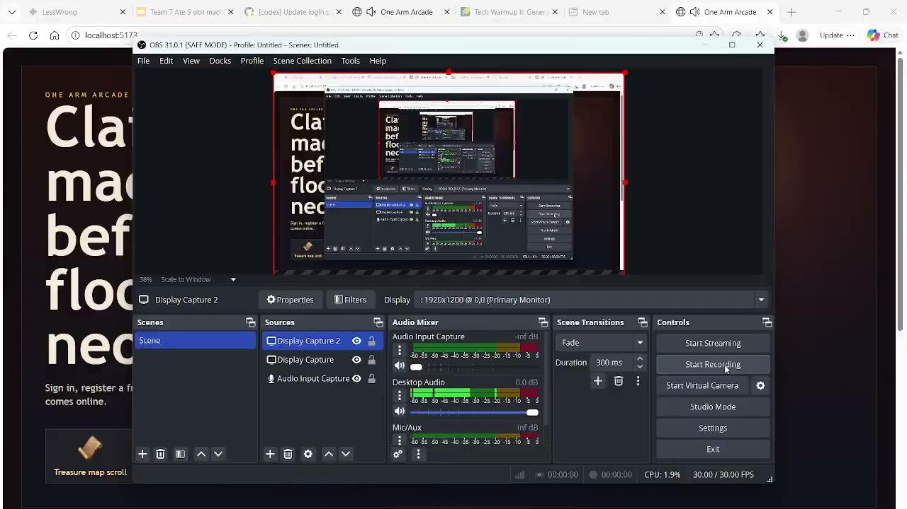
This is the Final Product!

